Slide 1
Electric Vehicle Charging Demand Prediction using Machine Learning
Goutham Kumar Javed Banoth

Slide 2
Contents
Introduction
Literature Review
Conclusions drawn from Literature Review
Objectives
Methodology
Work done till the presentation
Work to be Further Done
Results and Discussions
Conclusions
References

Slide 3
Introduction
The rapid growth of transportation sector and related emissions are attracting the attention of policymakers to ensure environmental sustainability.
Electric Vehicles (EVs) are considered one of the major pillars of smart transportation applications.
Public acceptance of EVs call for availability of charging infrastructure.
Charging infrastructure planning is a process involving various activities such as
Charging station placement, charging demand prediction, charging scheduling etc. and interaction of power distribution as well as road network.

Slide 4
Literature Review
Sl No. | Title of the paper | Authors, year of publication | Nature of work | Major findings
1. | Data-driven framework for large-scale prediction of charging energy in electric vehicles. | Yang Zhao et al. (2021) | Developed large scale charging energy predictions | Proposed a novel data-driven method that controls linear and nonlinear contributions in prediction modeling.
2. | Modelling the energy consumption of electric vehicles under uncertain and small data conditions. | Yang Liu et al. (2021) | Modelled Energy consumption of Evs under uncertain and small data conditions. | Proposed a Machine Learning Control Variable model and to estimated the trip energy consumption of Evs.
3. | Data-driven estimation of energy consumption for electric bus under real world driving conditions. | Yuche Chen et al. (2021) | Developed ML based Long Short Term Memory and Artificial Neural Network models. | Proposed a data partitioning algorithm to separate energy charging and discharging modes.

Slide 5
Contd.
Sl No. | Title of the paper | Authors, year of publication | Nature of work | Major findings
4. | Improved Prediction of Total Energy Consumption and Feature Analysis in Electric Vehicles Using Machine Learning and Shapley Additive Explanations Method | Sugam Pokharel (2021) | ML models such as multiple linear regression, XGBoost, SVR were used to investigate the total energy consumption by the EVs. | Compared the ML models performance along with the error analysis and external parameters are identified using the shapley additive explanations method
5 | Data-Driven Charging Demand Prediction at Public Charging Stations Using Supervised Machine Learning Regression Methods | Almaghrebi et al. (2020) | Collection of charging events from public charging stations and showing the results on energy demand | Three machine learning methods are used to predict the energy demand and through evaluation metrics, analyzing these method performances

Slide 6
Contd.
Sl No. | Title of the paper | Authors, year of publication | Nature of work | Major findings
6. | Machine Learning Approaches for EV Charging Behavior | Shahriar et al. (2020) | Focused on developing smart scheduling algorithms to manage the demand for public charging using modeling and optimization | Providing comprehensive review for the use of supervised and unsupervised ML as well as Deep Neural Networks for charging behavior analysis and prediction
7. | A Machine Learning Method for Predicting Driving Range of Battery Electric Vehicles | Sun et al. (2019) | To improve the driving range prediction accuracy to provide reliable information to EV users | Predicted Driving range using gradient boosting decision tree algorithm and compared with conventional multiple linear regression

Slide 7
Contd.
Sl No. | Title of the paper | Authors, year of publication | Nature of work | Major findings
8. | Prediction of energy consumption for new electric vehicle models by machine learning | Fukushima et al. (2021) | To recommend suitable EVs based on driving range and energy consumption | Predicted the energy consumption for new EVs using a new transfer learning method that constructs prediction models using other, more sufficient data on popular EV models.
9. | Household EV Charging Demand Prediction using Machine and Ensemble Learning | Ai et al. (2020) | To evaluate Household EV charging demand, which is a primary factor for designing smart EV solutions | Proposed a two-layer hybrid stacking ensemble learning method for better prediction

Slide 8
Contd.
Sl No. | Title of the paper | Authors, year of publication | Nature of work | Major findings
10. | Demand Prediction and Placement Optimization for Electric Vehicle Charging Stations | Gopalakrishnan et al. (2019) | Predicting Energy demand and optimal location of Charging station for EVs | a supervised multi-view learning framework using Canonical Correlation Analysis (CCA) for demand prediction
11. | Prediction of plug-in electric vehicle's state-of-charge using gradient boosting method and random forest method | Deb et al. (2020) | Prediction of State of charge which is a vital factor in order to decide the mode of operation. | Using GBM and random forest with additional trees to predict SOC

Slide 9
Contd.
Sl No. | Title of the paper | Authors, year of publication | Nature of work | Major findings
12. | Energy consumption analysis and prediction of electric vehicles based on real-world driving data | Zhang et al. (2021) | Prediction of energy consumption for optimal battery sizing, energy-efficient route planning and charging using real time data of Beijing city | Proposed a novel machine learning-based energy consumption prediction framework integrated with driving condition prediction
13. | Energy prediction for EVs using support vector regression methods | Grubwinkler and Lienkamp (2015) | Using normalized consumption values and speed profiles for various EVs to predict energy consumption | Prediction of Energy demand for EVs by training Support vector machines with historical data for accurate prediction

Slide 10
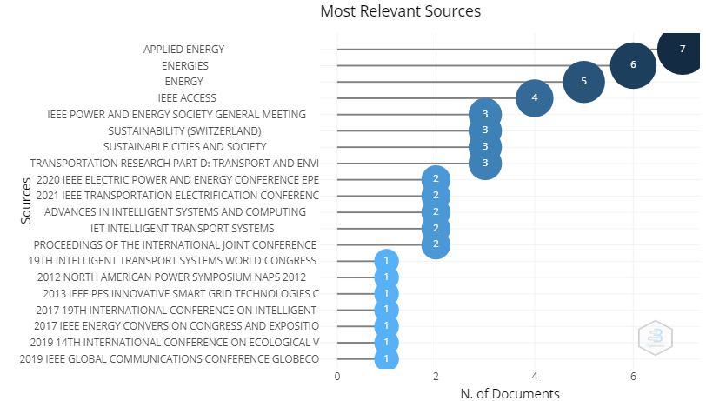
Most relevant sources

Slide 11
Most relevant Journal Names

Slide 12
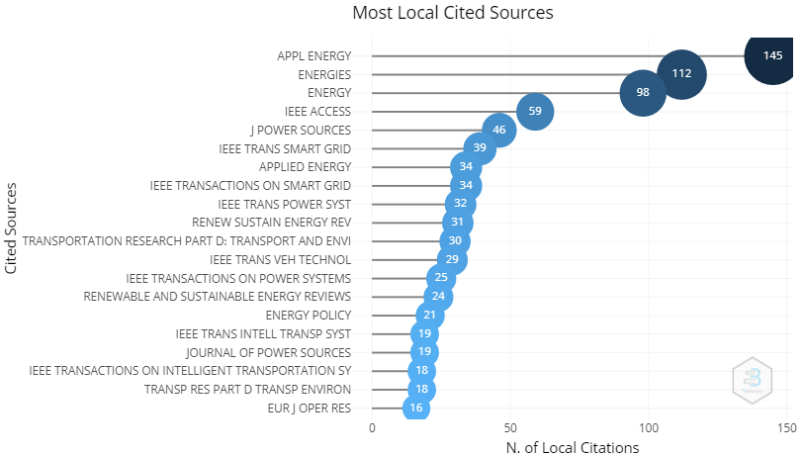
Most relevant sources

Slide 13
Conclusions drawn from Literature Review:
Electric Vehicles are best suited for sustainable transportation.
Effective placement of charging stations and energy demand prediction plays a key role in electric vehicle (EV) adoption.
To predict energy consumption of electric using various machine learning algorithms.
Determining the major factors for driving range prediction, optimal placement of charging stations, optimal battery sizing, energy-efficient route planning and charging infrastructures operations had been discussed.

Slide 14
Objectives:
Identifying the major parameters for prediction of Average Energy Consumption by Electric vehicles.
To predict Average Energy Consumption of Electric Vehicles using machine learning models.
To provide prediction results for various ML models based on their performance metrics and choosing the best model for further prediction.
To predict the minimum number of charging stations required in Bangalore city by creating realistic dataset.
To predict optimal placement of charging stations in a city using a well-organized dataset with all parameters taken into consideration.

Slide 15
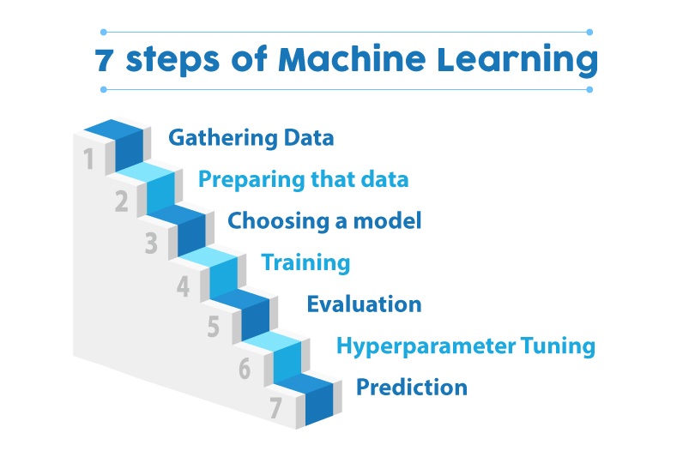
Methodology:
Steps in our Methodology

Slide 16
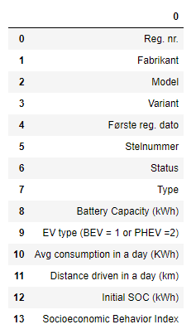
DATA SET:
We have taken a standard dataset from “Assessment of Real-Time Tariffs for Electric Vehicles in Denmark” article.
The dataset includes general characteristics for 11088 EVs (1974 plug-in hybrid electric vehicles and 9114 battery electric vehicles), such as registration number, manufacturer, model, registration year, battery capacity, average energy consumption, distance driven in one day, Initial state of charge, socioeconomic profile index, and vehicle type.

Slide 17
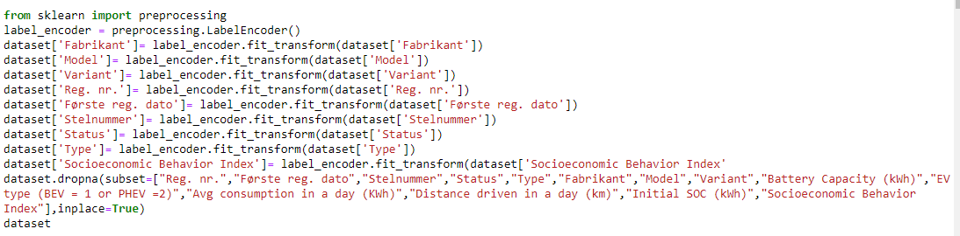
Dataset (Contd…)
Label Encoding:
We have performed Label encoding to 9 columns
Fabrikant, Model, Variant, Første reg. dato, Stelnummer, Status, Type, Socioeconomic Behavior Index ,

Slide 18
Pre Processing:
Data preprocessing is a process of preparing the raw data and making it suitable for a machine learning model
Pre Processing
Data Cleaning Missing values Null Values Removing F-characters
Data shaping
Labeling

Slide 19
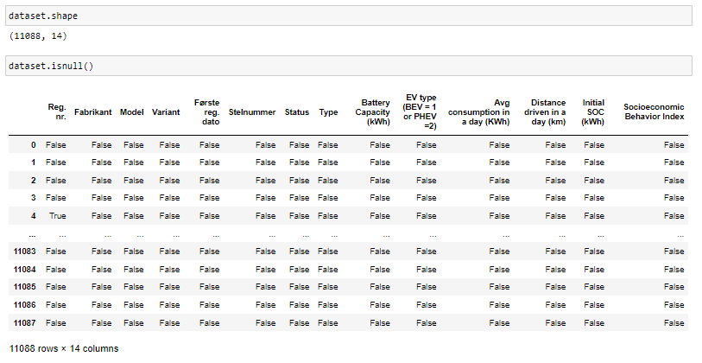
Before Preprocessing:
True indicates: That particular column has some null values

Slide 20
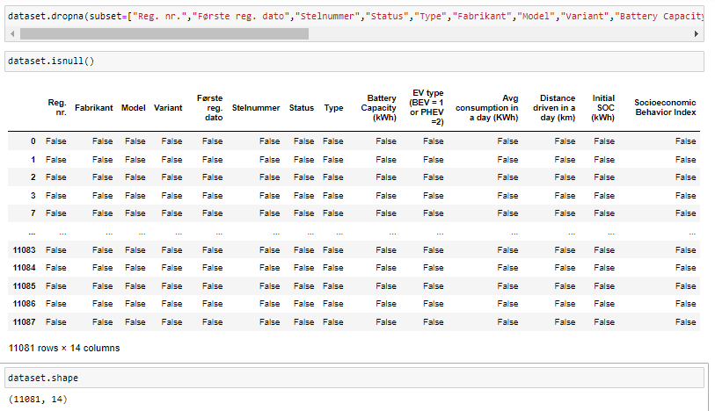
Now after applying some cleaning techniques those values are eliminated
After Preprocessing:
Hence, The numbers of rows are reduced from 11088 to 11081 rows.

Slide 21
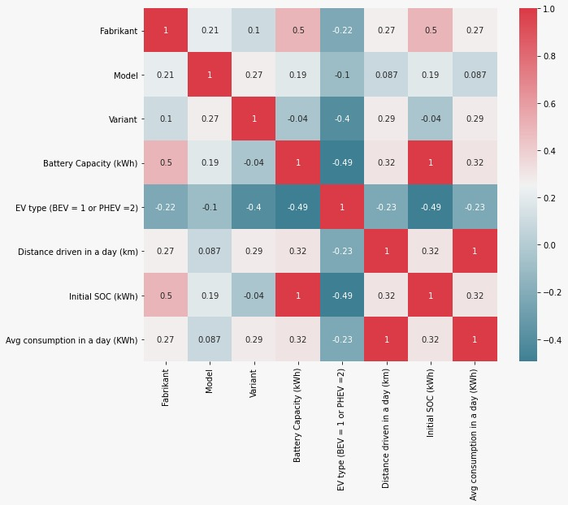
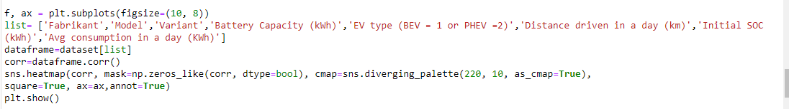
Data Visualization:
As a part of pre-processing, we performed Data Visualization
By using Data Visualization libraries we have plotted some correlation plots among some columns from this dataset.
From the correlation plot, we will be able to identify which parameter affects our output the most. We can use it in our linear regression model.
Code for correlation plot

Slide 22
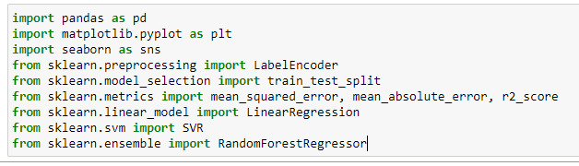
Libraries Used:
Algorithms Libraries:
1. Scikit-learn
1. sklearn.preprocessing i. LabelEncoder
2. sklearn.model_selection
ii. train_test_split
3. sklearn.metrics
iii. mean_squared_error,
iv. mean_absolute_error,
v. r2_score
4. sklearn.linear_model
vi. LinearRegression
5. sklearn.svm
vii. SVR
6. sklearn.ensemble
viii. RandomForestRegressor
Python Libraries: 1. Pandas
2. Numpy
Data Visualization Libraries:
1. Matplotlib
2. Seaborn

Slide 23
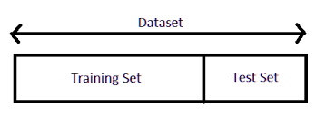
Splitting the Dataset:
We split the dataset into training and testing sets.
Training sets are used for training our models
(Supervised Learning → Labeling)
Testing set is used to predict the output.
Generally, splitting occurs like: Testing set=0.3 (30%) and
Training set=0.7 (70%)

Slide 24
ML Algorithms used:
Linear Regression
Random Forest
Support Vector Machine
Linear Regression
Random Forest
Support Vector Regression

Slide 25
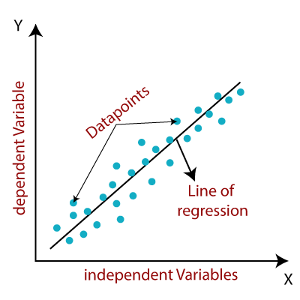
Linear Regression:
Data points (scatter plot)
All we are trying to do when we calculate our regression line is draw a line that’s as close to every dot as possible
For classical linear regression (Least Squares Method), we only measure the closeness in the up and down direction.
Generally, we calculate regression between dependent variable (what we are predicting) and independent variables (which are influencing the dependent variable)

Slide 26
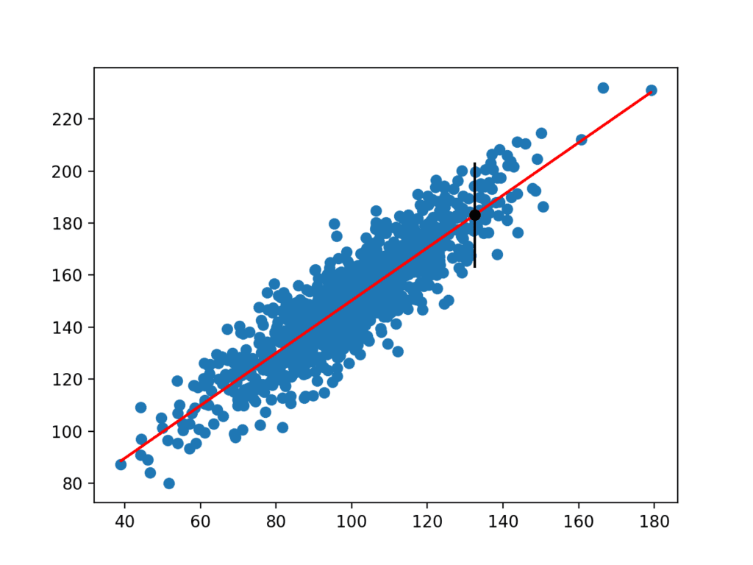
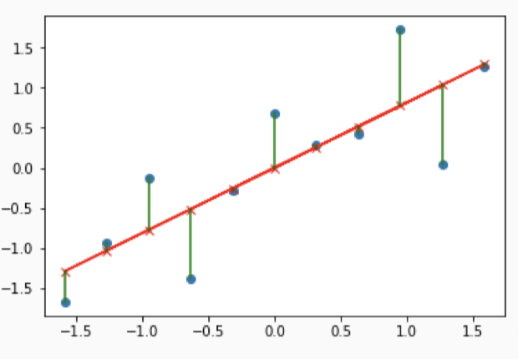
Contd…
Our main goal with linear regression is to minimize the vertical distance between all the data points and our line.
We will use least squares method, which is exactly fitted by minimizing the sum of squares of residuals
The residuals for an observation is the difference b/w the observation (y-value) and the fitted line.

Slide 27
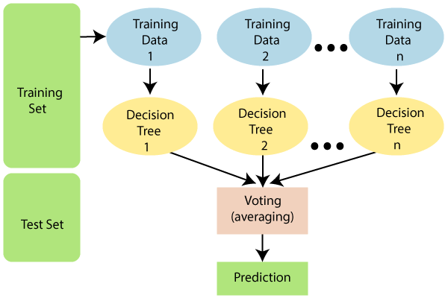
Random Forest:
It is made up of many decision trees.
It is an ensemble algorithm --- (Takes into account of more than one algorithms of different /same kind).
It uses two key concepts:
1. Random sampling of training data points when building trees.
2. Random subsets of features considered when splitting nodes.

Slide 28
How does Random Forest algorithm work?
It works in two-phase first is to create the random forest by combining N decision tree, and second is to make predictions for each tree created in the first phase.
Step-1: Select random K data points from the training set.
Step-2: Build the decision trees associated with the selected data points (Subsets)
Step-3: Choose the number N for decision trees that you want to build.
Step-4: Repeat steps 1 & 2.
Step-5: For new data points, find the predictions of each decision tree, and assign the new data points to the category wins the majority votes.

Slide 29
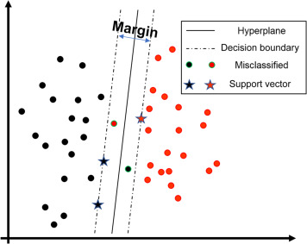
Support Vector Machine:
It analyzes the data and recognize patterns, used for classification and regression analysis.
In SVM’s, classification and regression analysis is almost same with small differences.
It creates a hyper plane through n-dimensional space.
It separates numerical data based on kernel function that maximizes the margin from the closest point to the hyper plane that divides data with the largest possible margins.
Support Vectors:
The Vector points which touches the margin lines.

Slide 30
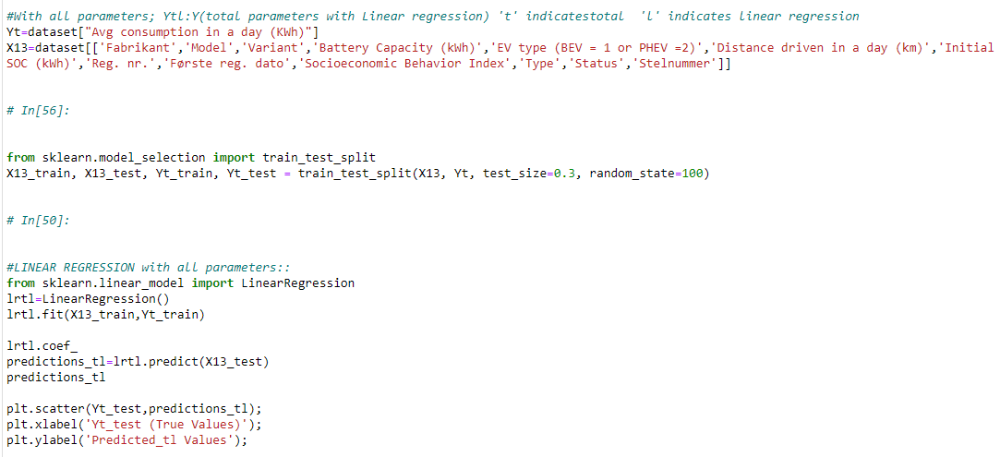
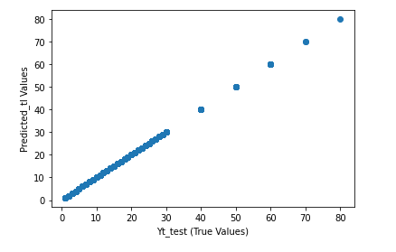
Results and Discussions:
Linear regression prediction using all parameters:

Slide 31
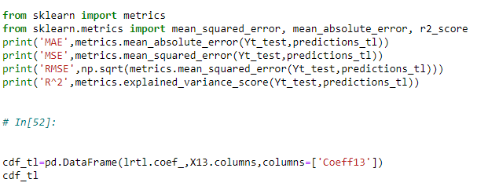

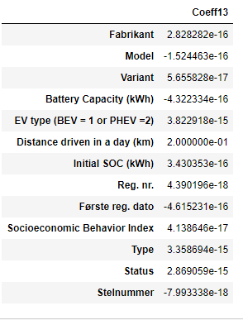
Performance Metrics :
These are the coefficients after predicting using Linear Regression
Coefficients

Slide 32
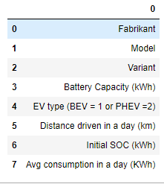
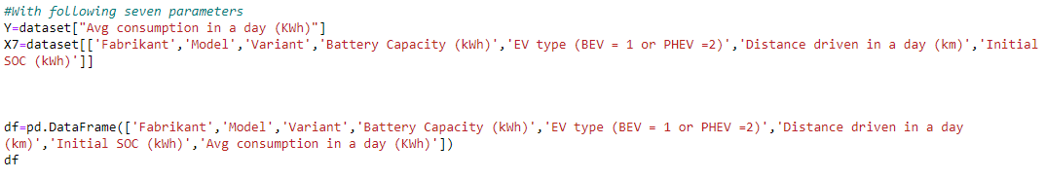
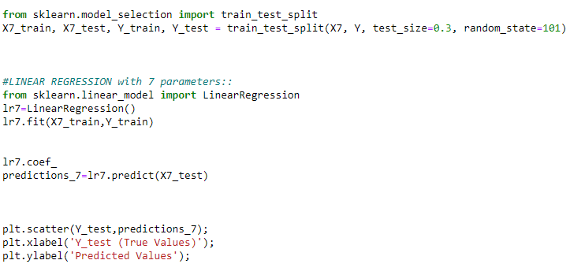
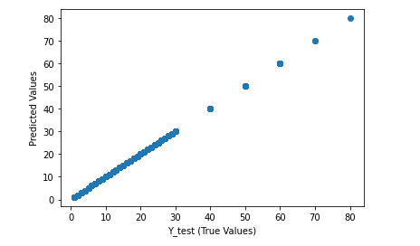
Linear Regression prediction using seven parameters:

Slide 33
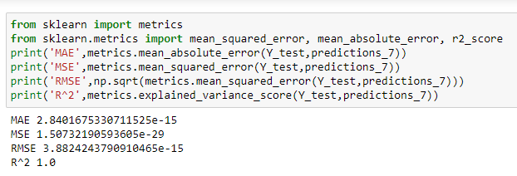
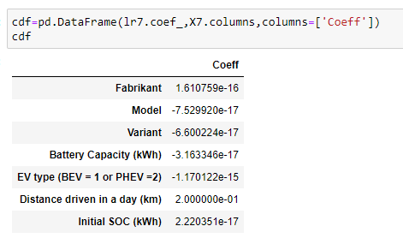
Performance Metrics :

Slide 34
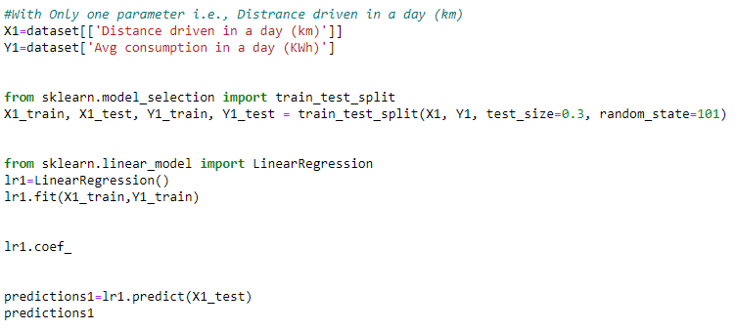
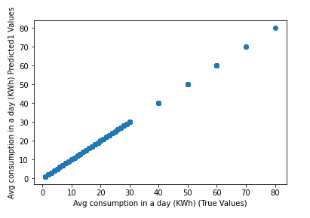
Linear Regression prediction using one parameter:

Slide 35
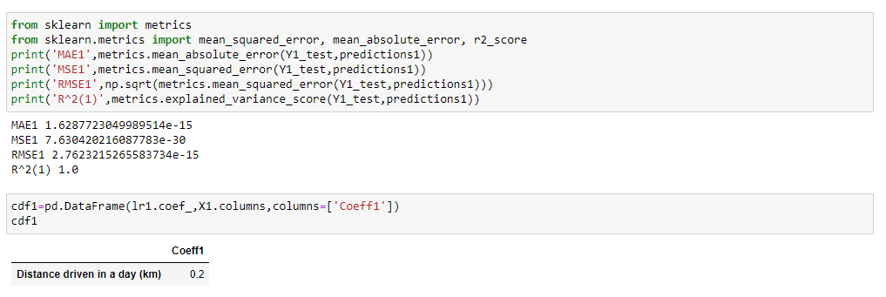
Performance Metrics:

Slide 36
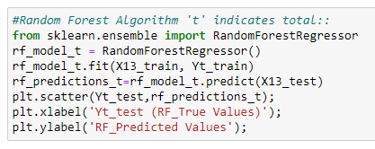
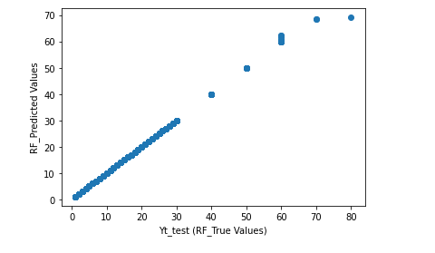
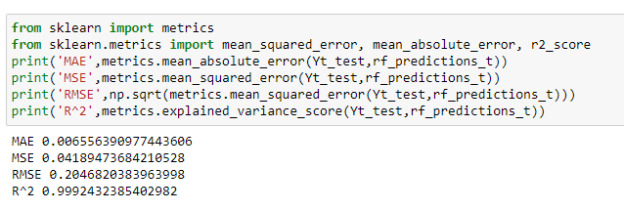
Random Forest prediction using all parameters:
Performance Metrics :

Slide 37
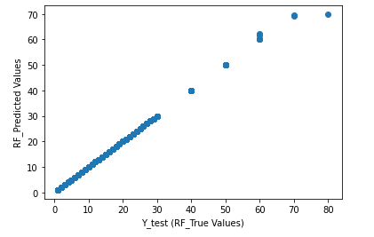
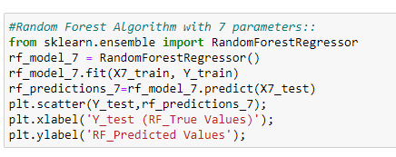
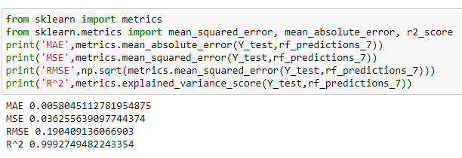
Random Forest prediction using seven parameters:
Performance Metrics :

Slide 38
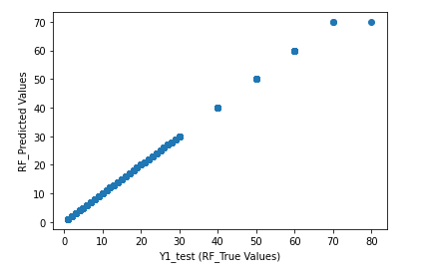
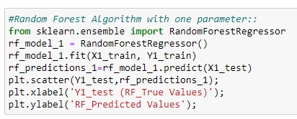
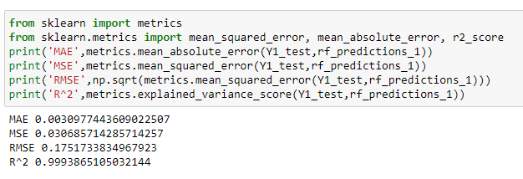
Random Forest prediction using one parameter:
Performance Metrics :

Slide 39
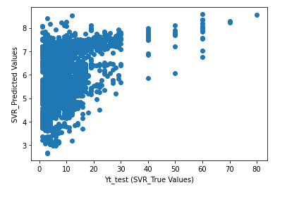
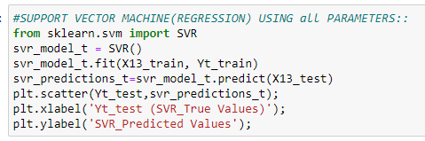
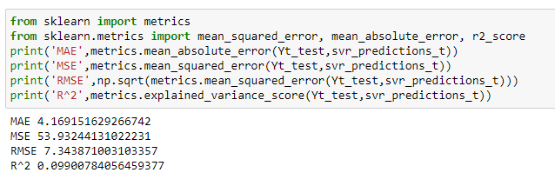
Support Vector Regressor prediction using all parameters:
Performance Metrics:

Slide 40
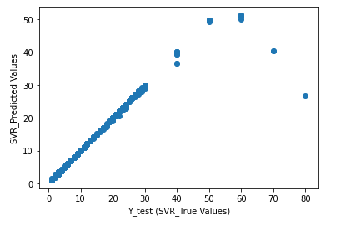
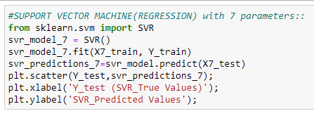
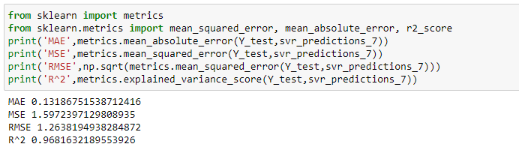
Support Vector Regressor prediction using seven parameters:
Performance Metrics:

Slide 41
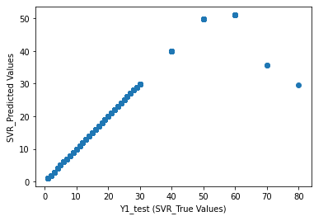
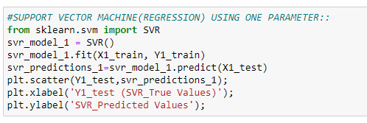
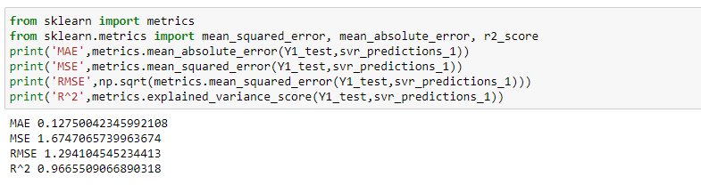
Support Vector Regressor prediction using one parameter:
Performance Metrics:

Slide 42
Comparison for various performance metrics among three ML Models:
MAE | LINEAR REGRESSION | SVR | RANDOM FORREST
THIRTEEN PARAMETERS | 1.62E-13 | 4.169151629 | 0.006556391
SEVEN PARAMETERS | 2.84E-15 | 0.131867515 | 0.005804511
ONE PARAMETER | 1.63E-15 | 0.127500423 | 0.003097744
MSE | LINEAR REGRESSION | SVR | RANDOM FORREST
THIRTEEN PARAMETERS | 4.06E-26 | 53.93244131 | 0.041894737
SEVEN PARAMETERS | 1.51E-29 | 1.597239713 | 0.036255639
ONE PARAMETER | 7.63E-30 | 1.674706574 | 0.030685714

Slide 43
Contd..
RMSE | LINEAR REGRESSION | SVR | RANDOM FORREST
THIRTEEN PARAMETERS | 2.02E-13 | 7.34871003 | 0.204682038
SEVEN PARAMETERS | 3.88E-15 | 1.263819494 | 0.190409136
ONE PARAMETER | 2.76E-15 | 1.294104545 | 0.175173383
R^2 | LINEAR REGRESSION | SVR | RANDOM FORREST
THIRTEEN PARAMETERS | 1 | 0.099007841 | 0.999243239
SEVEN PARAMETERS | 1 | 0.968163219 | 0.9992744948
ONE PARAMETER | 1 | 0.966550907 | 0.999386511

Slide 44
Conclusions:
On comparing the errors among each models (Linear regression, SVR, Random Forrest) least values/errors(MAE,MSE,RMSE) are observed on simple linear regression model.
Also comparing the R^2/accuracy among each models(Linear - regression, SVR, Random Forrest) highest R^2 values are observed on simple linear regression model.
On basis of these two factors we came to conclude that simple linear regression model is the best fit.

Slide 45
References:
Almaghrebi, A., Aljuheshi, F., Rafaie. M., James, K., and Alahmad, M., 2020. Energies: Data-Driven Charging Demand Prediction at Public Charging Stations Using Supervised Machine Learning Regression Methods. Data Mining Applications for Charging of Electric Vehicles . Energies, 13, 4231.
Shahriar, S., Al-Ali, A.R., Osman, A. H., Dhou, S., and Nijim, M., 2020. Machine Learning Approaches for EV Charging Behavior: A Review. IEEE Access, 8, 168980- 168993.
Gopalakrishnan, R., Biswas, A., Lightwala, A., Vasudevan, S., Dutta, & P., Tripathi,A., “Demand Prediction and Placement Optimization for Electric Vehicle Charging Stations”. Artificial Intelligence, pp. 3117-3123, 2016.
Sun, S., Zhang, J., Bi, J., & Wang, Y., “A Machine Learning Method for Predicting Driving Range of Battery Electric Vehicles”. Machine Learning in Transportation, vol. 2019, 2019.
Fukushima, A., Yano, T., Imahara, S., Aisu, H., Shimokawa, Y., & Shibata, Y., “Prediction of energy consumption for new electric vehicle models by machine learning”. IET Intelligent Transport Systems, 12(9), 1174–1180, 2018.
Zhang, J., Wang, Z., Liu, P., & Zhao, Z., “Energy consumption analysis and prediction of electric vehicles based on real-world driving data”. Applied Energy, vol. 275(C), 2020.
Grubwinkler, S., & Lienkamp, M., “Energy Prediction for EVs Using Support Vector Regression Methods”. Intelligent Systems, vol. 323, 2015.

